Slide 1
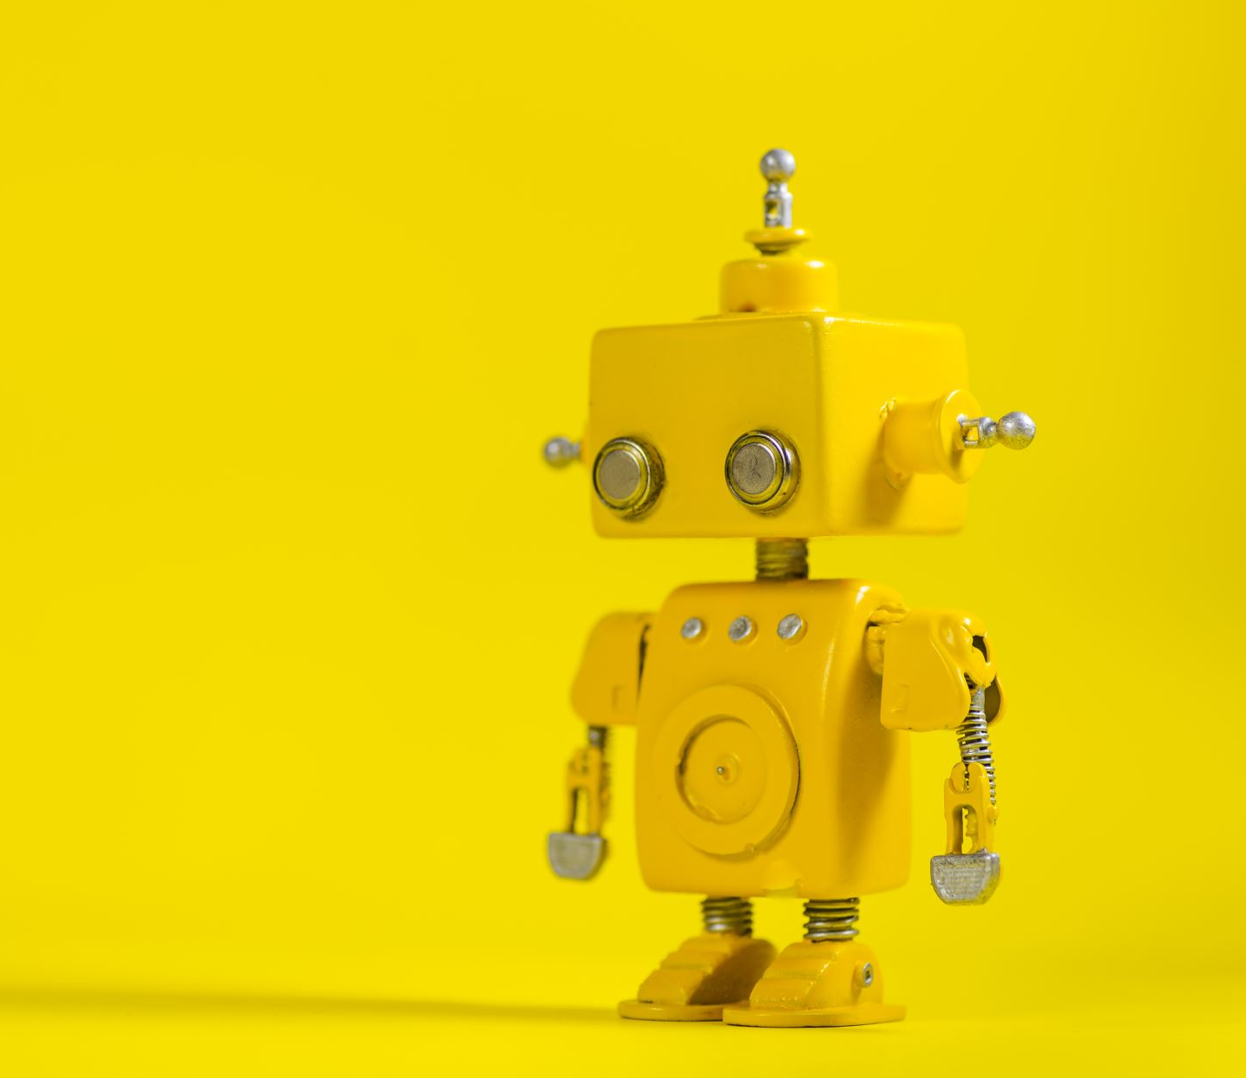
INTELLIGENT SYSTEMS & ROBOTICS
CE801: Assignment
Name: Kunal Gaurav
Reg no.: 2003391
Email: kg20952@essex.ac.uk

Slide 2
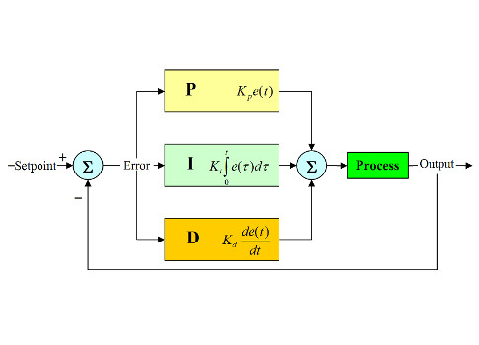
PID Controller
Proportional-Integral-Derivative (PID) control is the most common control algorithm used in industry and has been universally accepted in industrial control. The popularity of PID controllers can be attributed partly to their robust performance in a wide range of operating conditions and partly to their functional simplicity, which allows engineers to operate them in a simple, straightforward manner.
Block diagram of a basic PID control algorithm.

Slide 3
Parameter Tuning
I selected the parameters by some trial-and-error methodology.
Steps:
Started with a very small P coefficient
Initially I kept the I and D coefficient equal to 0
Then I increased the P coefficient until I saw some oscillation.
Then adjusted the value in the same way.
Parameter Choice
K_{p} = 2.0
K_{i} = 0.01
K_{d} = 0.2

Slide 4
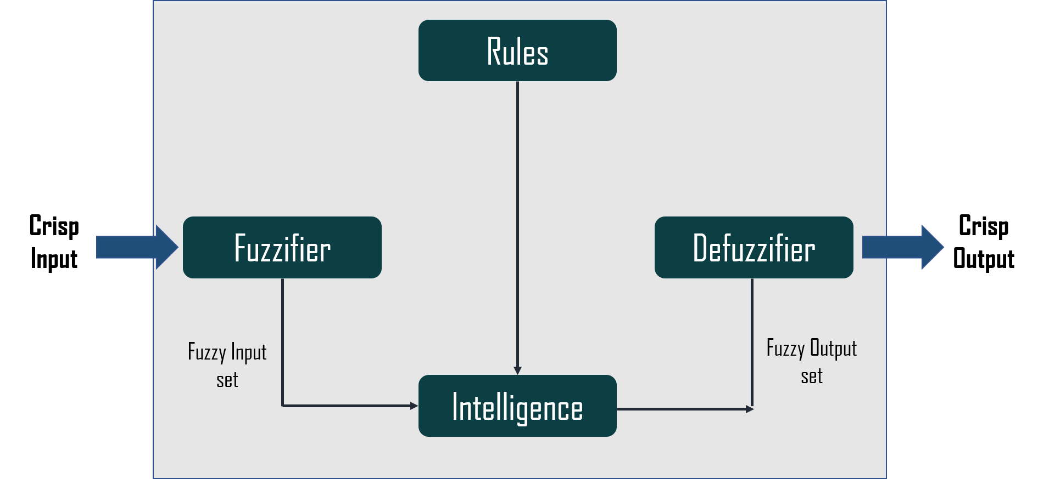
Fuzzy Logic Control System
A fuzzy control system is a control system based on fuzzy logic—a mathematical system that analyzes analog input values in terms of logical variables that take on continuous values between 0 and 1, in contrast to classical or digital logic, which operates on discrete values of either 1 or 0.

Slide 5
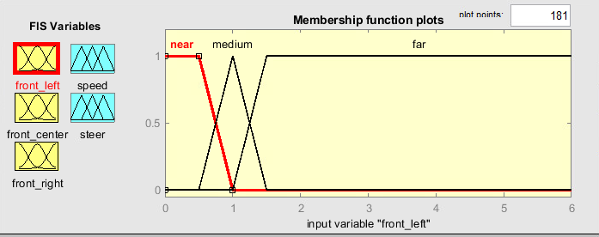
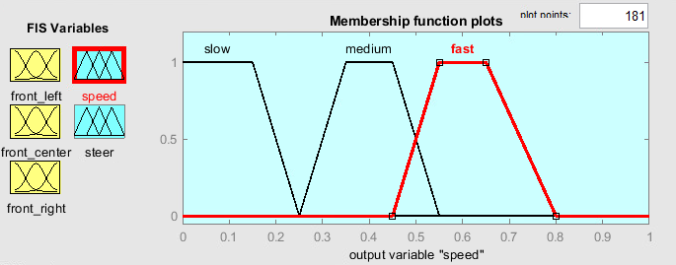
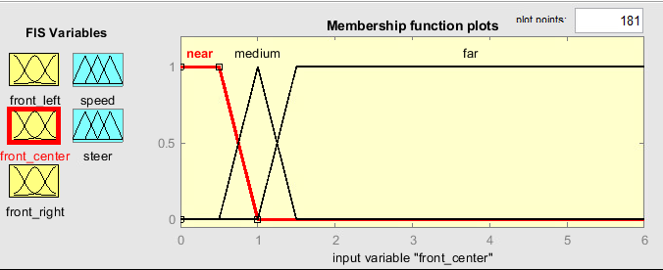
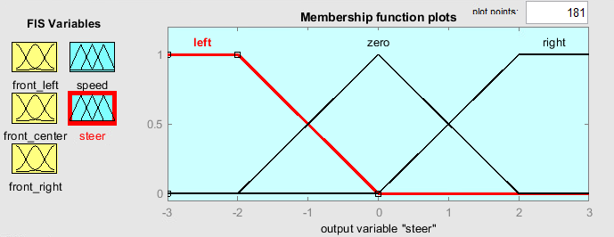
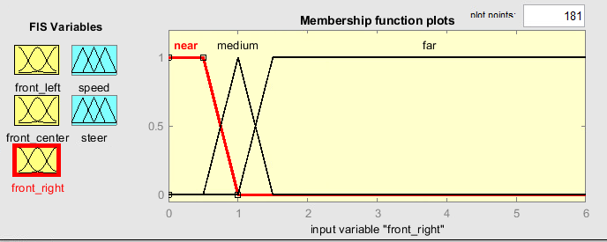
MFs for Obstacle Avoidance

Slide 6
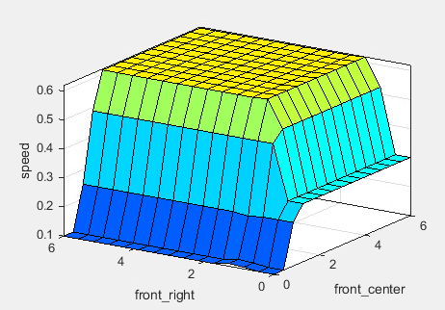
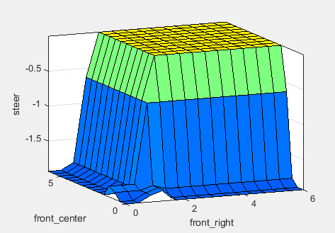
Surface Diagram for Obstacle Avoidance
Surface diagram for Speed
Surface diagram for Steer

Slide 7
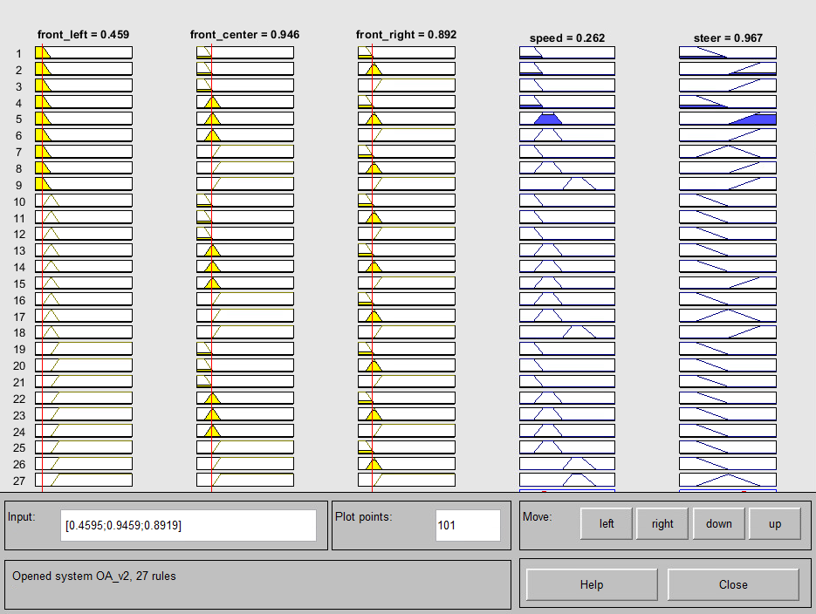
Rule Evaluation for Obstacle Avoidance

Slide 8
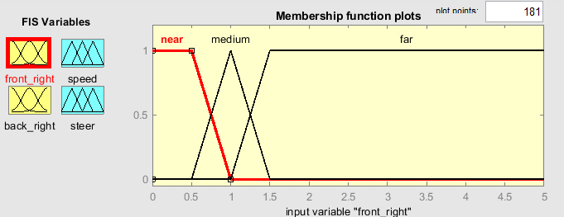
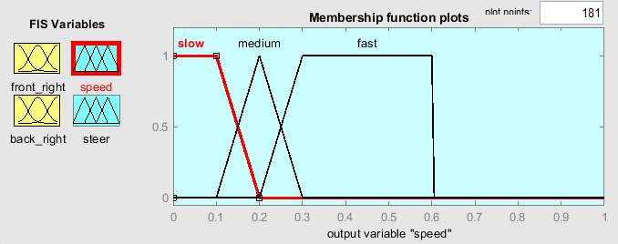
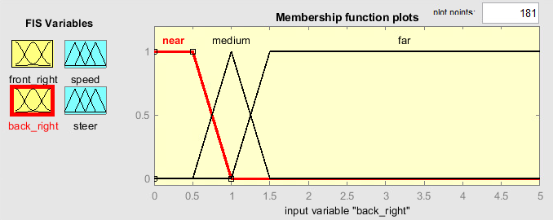
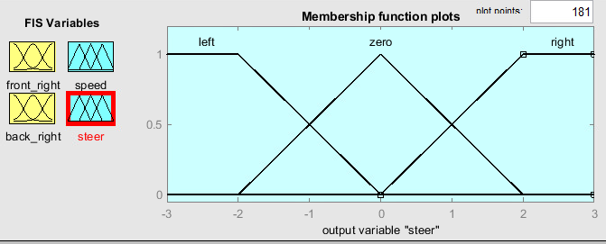
MFs for Right Wall Following

Slide 9
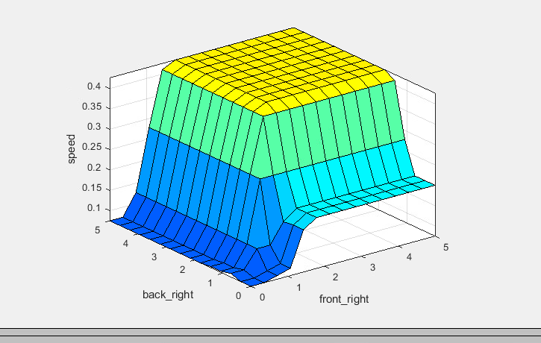
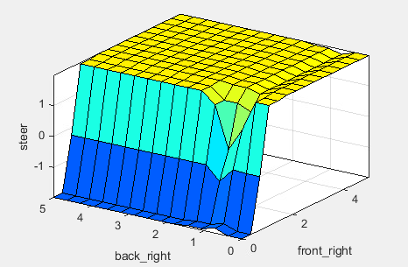
Surface Diagram of Right Wall Following
Surface diagram for Speed
Surface diagram for Steer

Slide 10
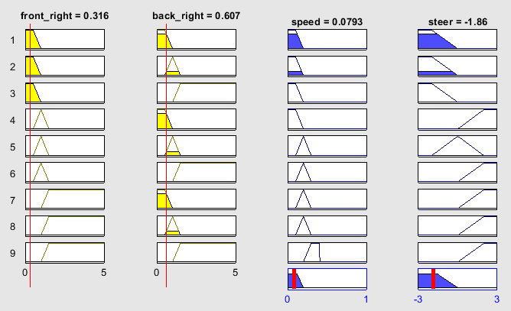
Rule Evaluation of Right Wall Following

Slide 11
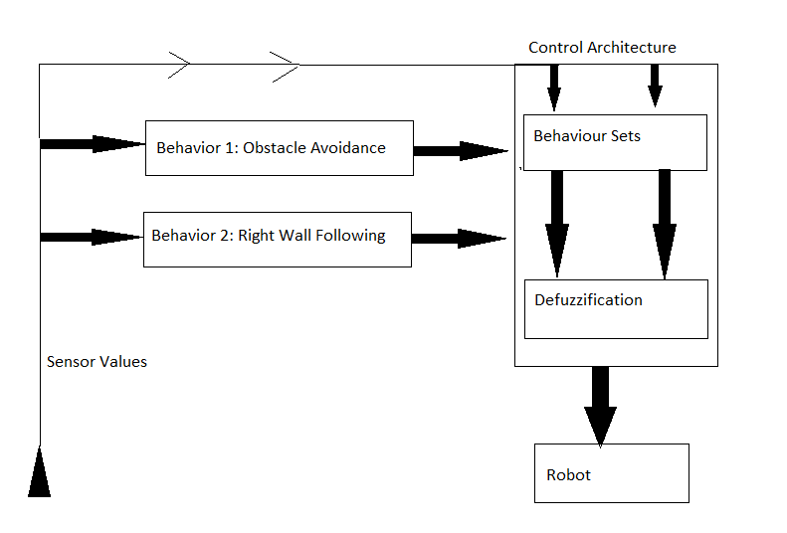
Behavior based control architecture
Behavior based control architecture basically decides the intensity of two behaviors given a particular scenario.
If there is an obstacle in front of the robot then Obstacle Avoidance(OA) behavior gets higher intensity and vice versa.

Slide 12
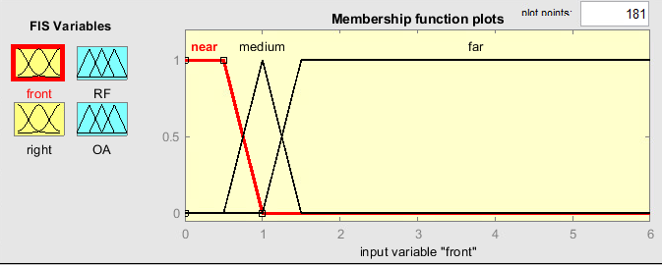
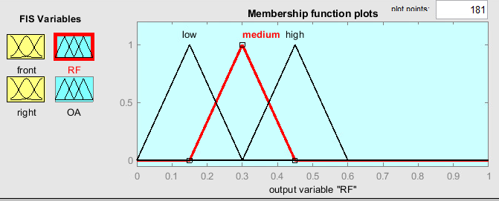
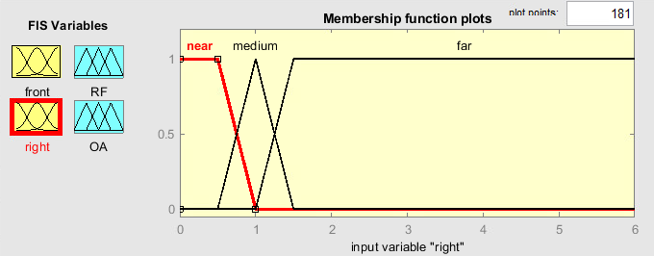
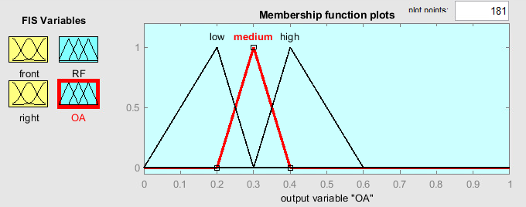
MFs for Behavior (Control Architecture)

Slide 13
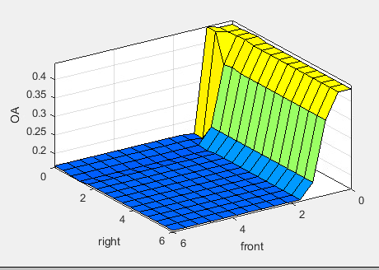
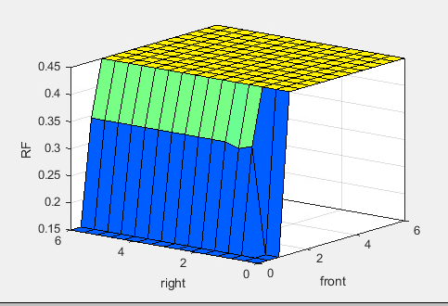
Surface Diagram for Behavior
Surface diagram for Obstacle Avoidance
Surface diagram for Right Following

Slide 14
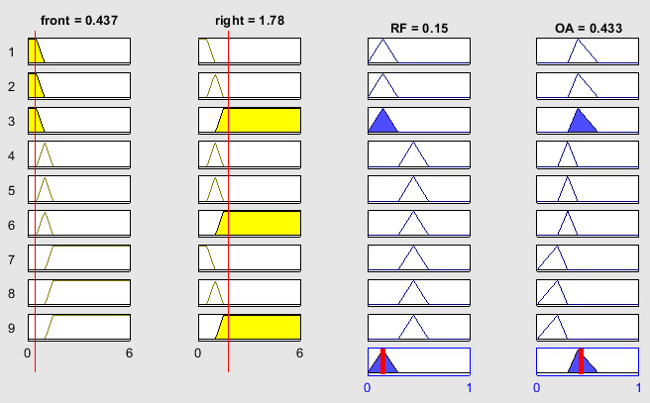
Rule evaluation for Behavior

Slide 15
THANK YOU

